Slide 1

Internship Project on
Student-Teacher Booking System
Department of Computer Science & Engineering
National Institute of Technology Patna
Under the Supervision of :
Dr. Rajib Ghosh
Presented by :
Rupesh (2106005)

Slide 2
CONTENT
About company
Internship details
Introduction
Tech stack used
Folder structure
Key features
Output
Future works
thank you
Problem Statement

Slide 3
ABOUT COMANY
NAME – UNIFIED MENTOR
LOCATION - DLF Forum, Cybercity, Phase III, Gurugram, Haryana 122002
IT PROVIDES INDUSTRIAL TRAINING AND INTERNSHIP
IT WORKS ON REAL WORLD PROBLEM AND SOLUTION

Slide 4
INTERNSHIP DETAILS
TOPIC –STUDENT TEACHER BOOKING SYSTEM
ROLE – FULL STACK DEVELOPER
START DATE – 01/01/2025
END DATE – 01/07/2025
DURATION - 6 MONTH

Slide 5
PROBLEM STATEMENT
1. Manual Scheduling Issues:
• Students faced difficulties in booking meeting slots with teachers.
• Overlapping schedules and last-minute cancellations caused confusion.
2. Lack of a Centralized System:
• No structured way to track available slots or manage appointments efficiently.
3. Communication Gaps:
• Students were unsure about teachers’ availability.
• Teachers often received multiple requests through different channels, making it hard to manage bookings.

Slide 6
INTRODUCTION
The frontend is built using React (Vite) for fast rendering.
Designed for students, teachers, and admins with different dashboards.
Ensures an easy and responsive appointment booking experience.

Slide 7
TECH STACK USED
React (Vite) – Frontend framework
Tailwind CSS – Styling
React-Router – Page navigation
Axios – API requests
React-Toastify – User notifications

Slide 8
FOLDER STRUCTURE
src/ → Contains all frontend code components/ → Reusable UI components
pages/ → Different dashboard pages
services/ → API calls using Axios
styles/ → Custom styles (if any)

Slide 9
KEY FEATURES
Student Panel: Register, book, and cancel appointments.
Teacher Panel: Approve/cancel bookings, manage schedules.
Admin Panel: Manage users, approve students.
Notifications: Uses React-Toastify for alerts.

Slide 10
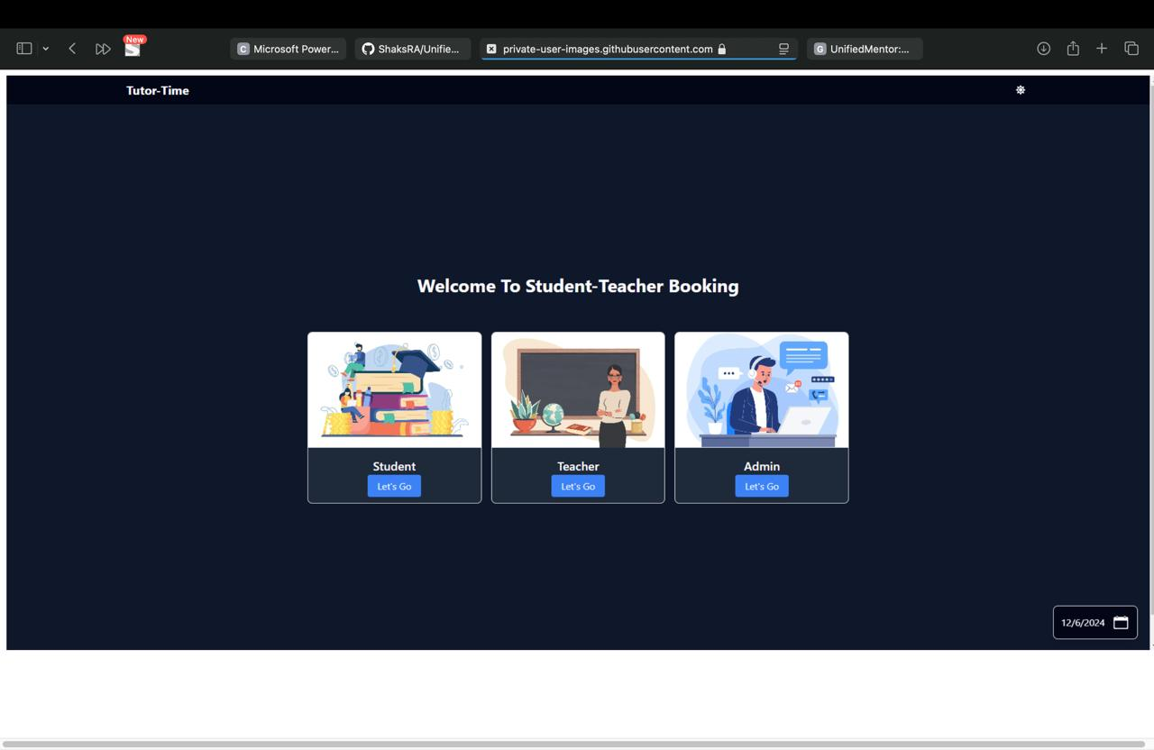
UI PREVIEW

Slide 11
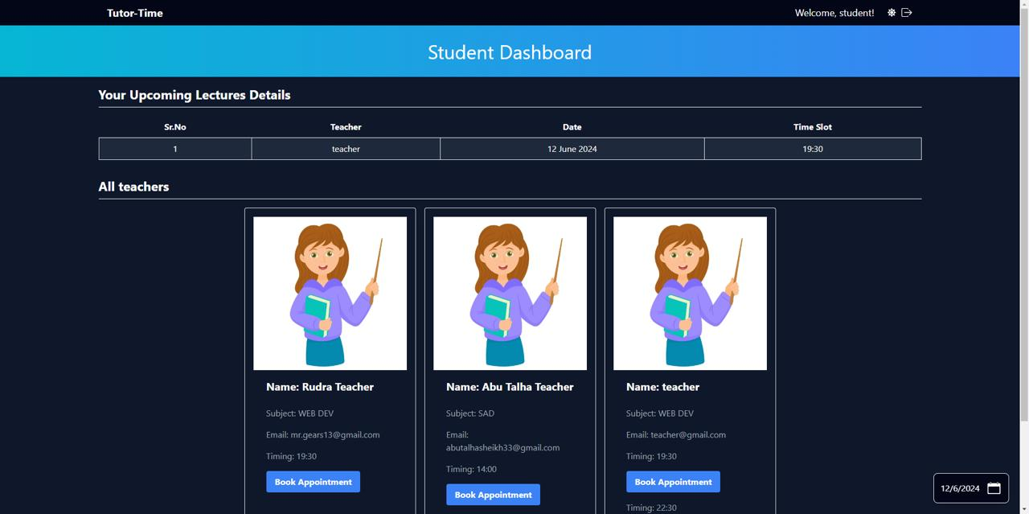
UI PREVIEW

Slide 12
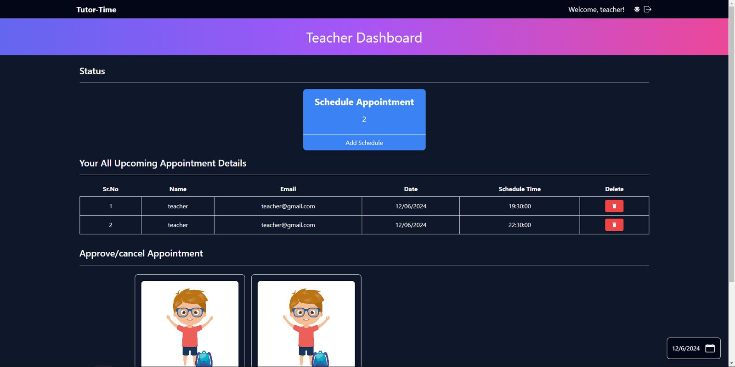
UI PREVIEW

Slide 13
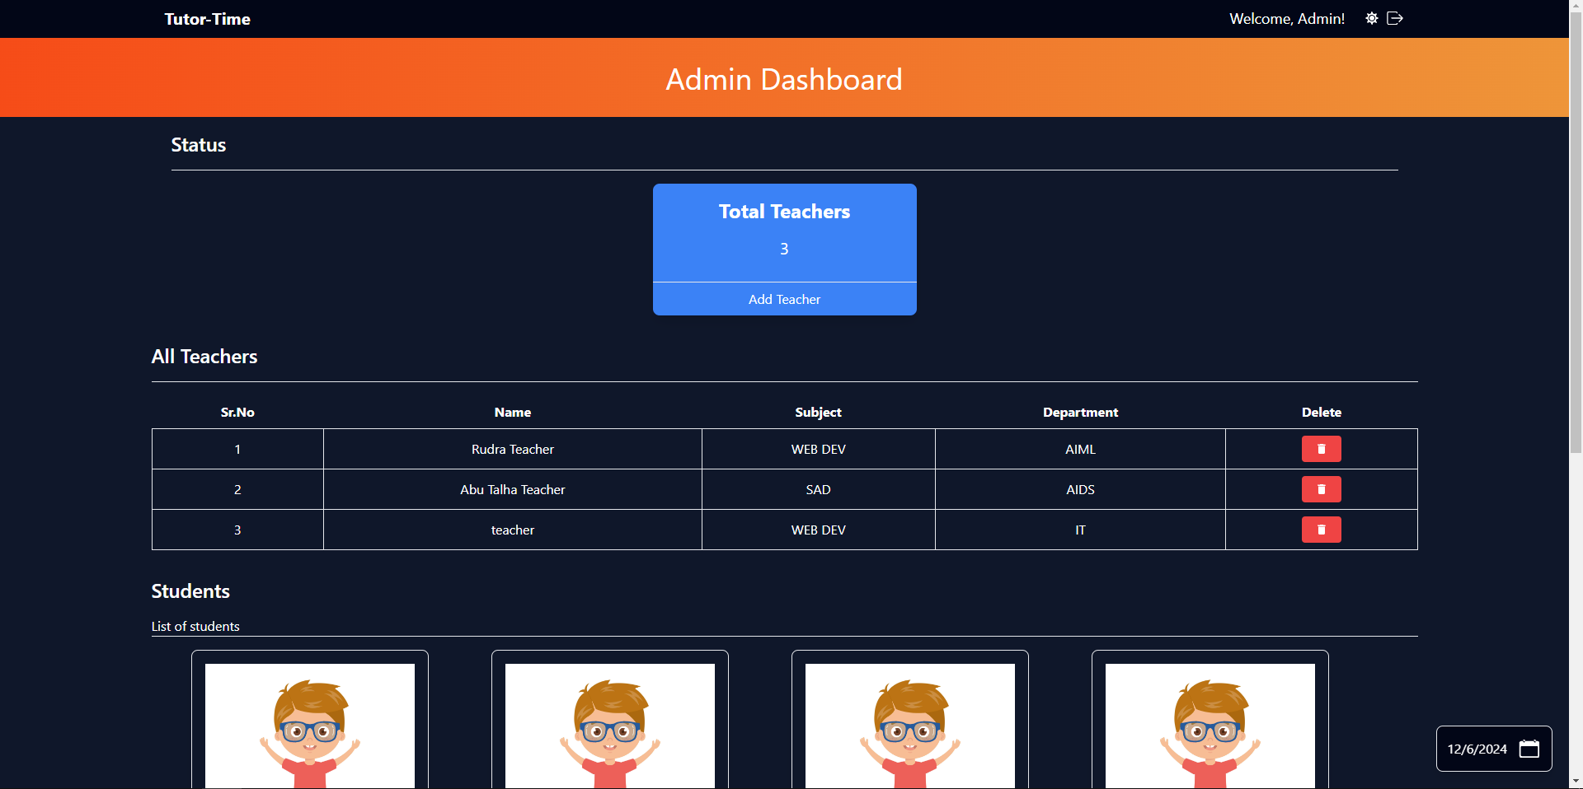
UI PREVIEW

Slide 14
FUTURE WORK
Complete API Connectivity – Connect frontend with the backend for real-time data.
Authentication – Implement JWT-based login for students, teachers, and admins.
Database Integration – Store appointment data in MongoDB.
Role-Based Access – Restrict pages based on user type.
Performance Optimization – Improve frontend performance with lazy loading.

Slide 15

Thank you

